Slide 1
SUPPLY CHAIN ANALYTICS
Supply Chain Visibility System
with Optimization Analytics
An interactive Power BI dashboard for end-to-end supply chain performance analysis — sales, inventory, delivery, supplier, transportation and warehouse.
TEAM :
Amit Kumar · Arun Kumar · Charmmy Lalwani

Slide 2
PROJECT OVERVIEW
Project Overview & Objectives
WHAT WE BUILT
KEY OBJECTIVES
An interactive Power BI dashboard built for full supply chain analysis
Sales, inventory, delivery, supplier, transportation and warehouse data analyzed together
Raw operational data converted into KPIs, trends and business insights
One centralized dashboard for monitoring overall performance
1
Monitor overall supply chain performance
2
Analyze inventory and product demand
3
Track delivery and fulfillment performance
4
Evaluate supplier and transportation performance
5
Measure warehouse efficiency
6
Support data-driven decisions
TOOLS USED
Power Query
Star Schema
DAX
Power BI
02

Slide 3
PROJECT MILESTONES
Four Milestones, One Integrated Dashboard
1
MILESTONE 1
2
MILESTONE 2
Data Modeling & KPI Foundation
Inventory & Delivery Analytics
Cleaned and transformed raw data with Power Query
Built a structured star schema model
Defined foundational KPIs: inventory value, turnover, delivery days
Inventory value and turnover analyzed by category & market
On-time delivery % and fulfillment rate tracked
Late-risk orders and delivery trends monitored
3
MILESTONE 3
4
MILESTONE 4
Supplier & Transportation Analytics
Warehouse Analytics & Final Dashboard
Supplier scorecards and performance ratings built
Transportation cost analyzed by mode and region
Carrier on-time delivery and accuracy evaluated
Warehouse efficiency and cost-per-order KPIs created
Capacity and storage economics analyzed
Milestones 1–4 consolidated into one final dashboard
03

Slide 4
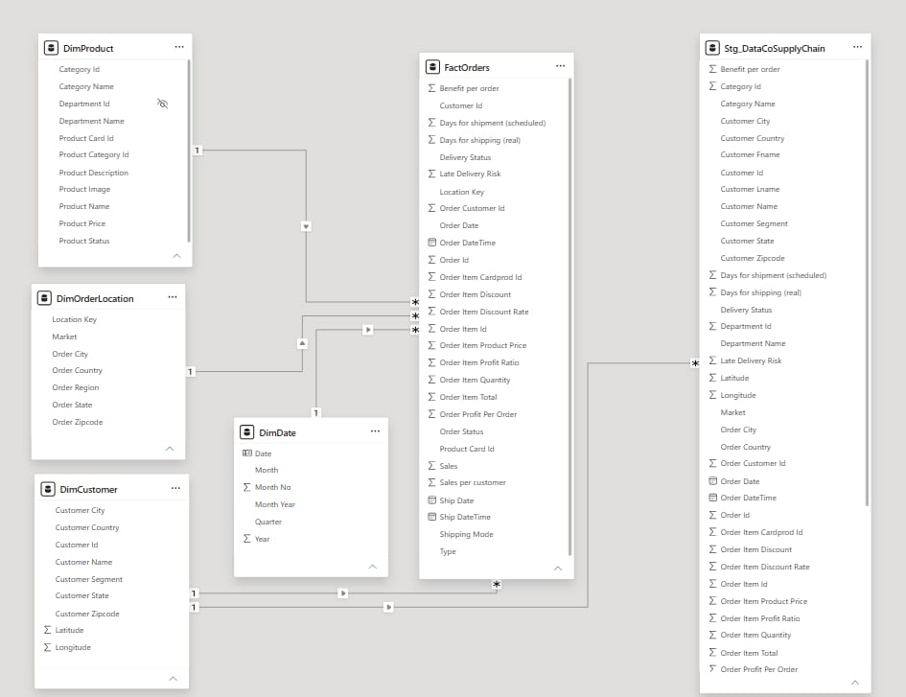
DATA MODEL
Star Schema Data Model
HOW THE MODEL IS STRUCTURED
Fact table
FactOrders holds order, sales, shipping and profit measures at line-item grain
Dimension tables
DimProduct, DimCustomer, DimDate and DimOrderLocation describe every order
Relationships
One-to-many links connect each dimension to the fact table
Why a star schema
Keeps the model simple, improves query performance and simplifies DAX
Purpose
Central foundation for every KPI, chart and cross-filter in the dashboard
04

Slide 5
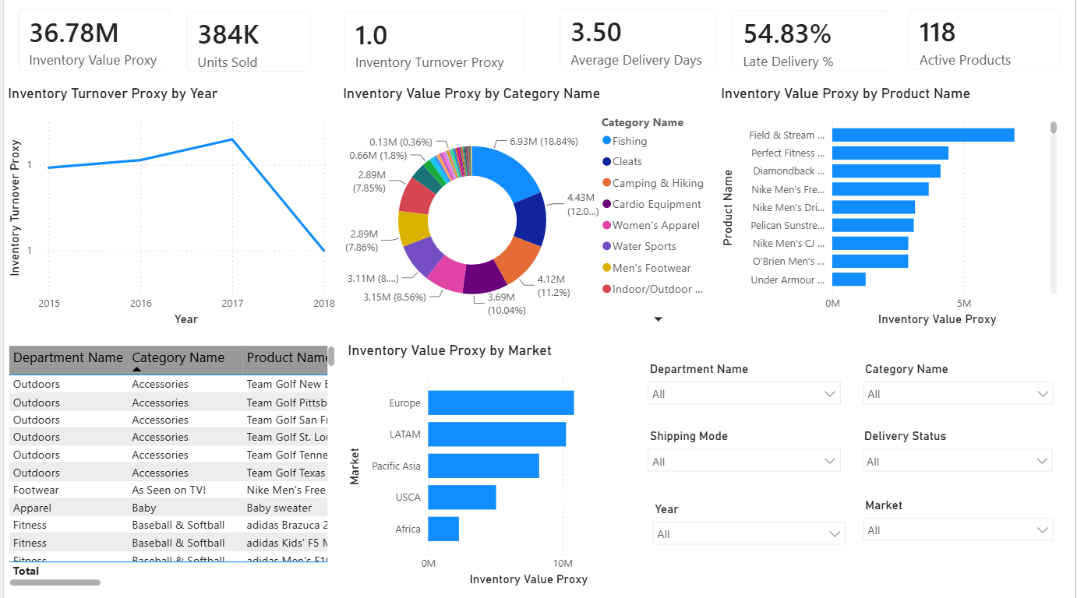
MILESTONE 1 · DASHBOARD
Data Modeling & KPI Foundation
36.78M
INVENTORY VALUE PROXY
384K
UNITS SOLD
118
ACTIVE PRODUCTS
Foundational KPI view built on the new star-schema model — inventory value, turnover, units sold and delivery days by category and market.
05

Slide 6
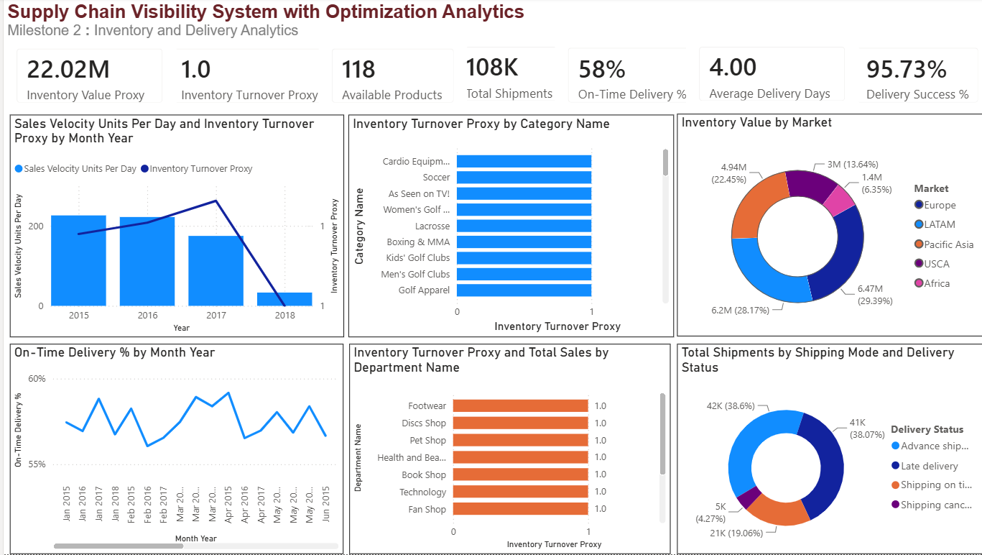
MILESTONE 2 · DASHBOARD
Inventory & Delivery Analytics
22.02M
INVENTORY VALUE PROXY
108K
TOTAL SHIPMENTS
95.7%
DELIVERY SUCCESS %
Inventory levels and turnover tracked by category and market, alongside on-time delivery, fulfillment rate and shipment status.
06

Slide 7
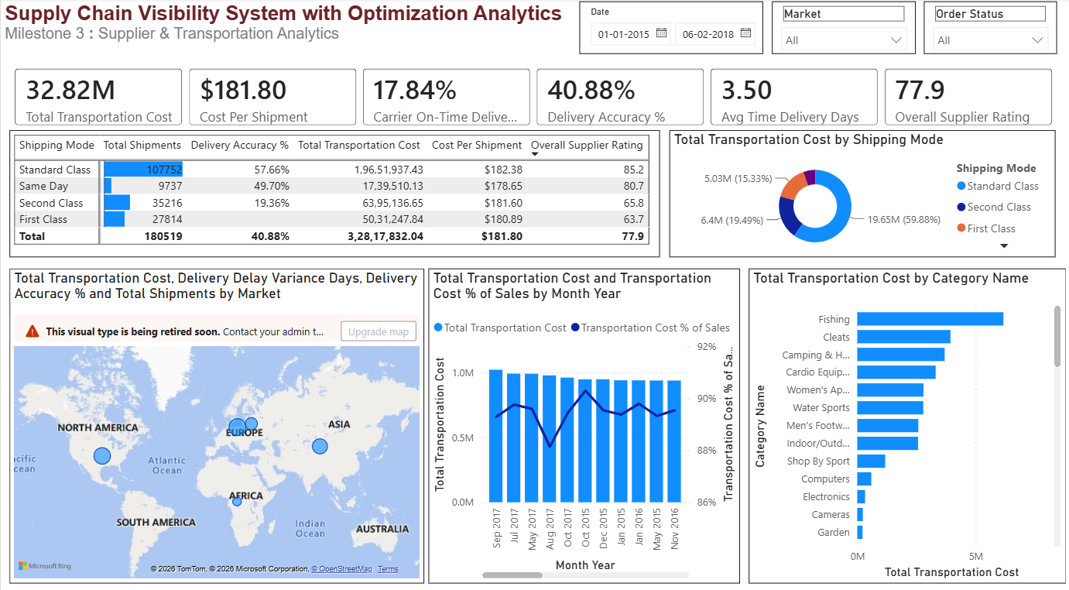
MILESTONE 3 · DASHBOARD
Supplier & Transportation Analytics
32.82M
TOTAL TRANSPORTATION COST
40.9%
DELIVERY ACCURACY %
77.9
OVERALL SUPPLIER RATING
Supplier scorecards and transportation cost analyzed by shipping mode, carrier and region to flag delivery and cost risks.
07

Slide 8
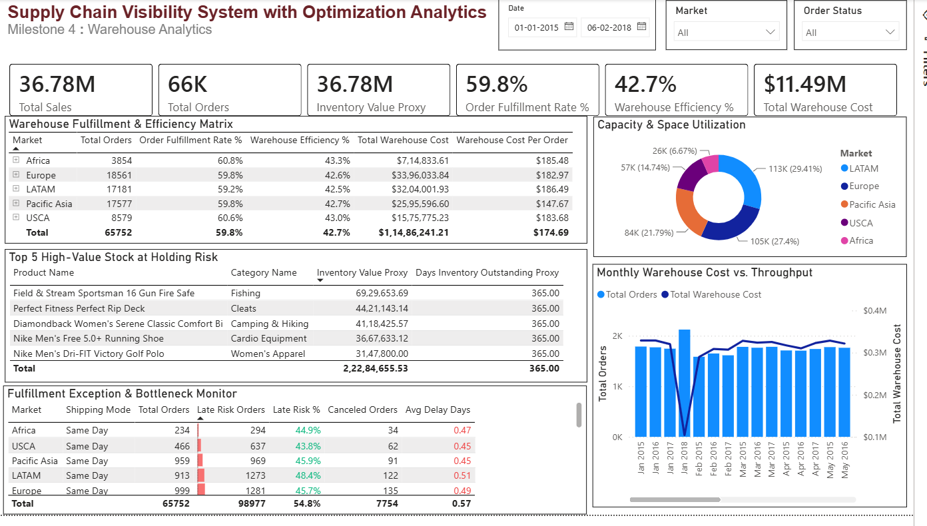
MILESTONE 4 · DASHBOARD
Warehouse Analytics & Final Dashboard
36.78M
TOTAL SALES
42.7%
WAREHOUSE EFFICIENCY
$11.49M
TOTAL WAREHOUSE COST
Warehouse efficiency and cost consolidated with Milestones 1–3 into one integrated, filterable executive dashboard.
08

Slide 9
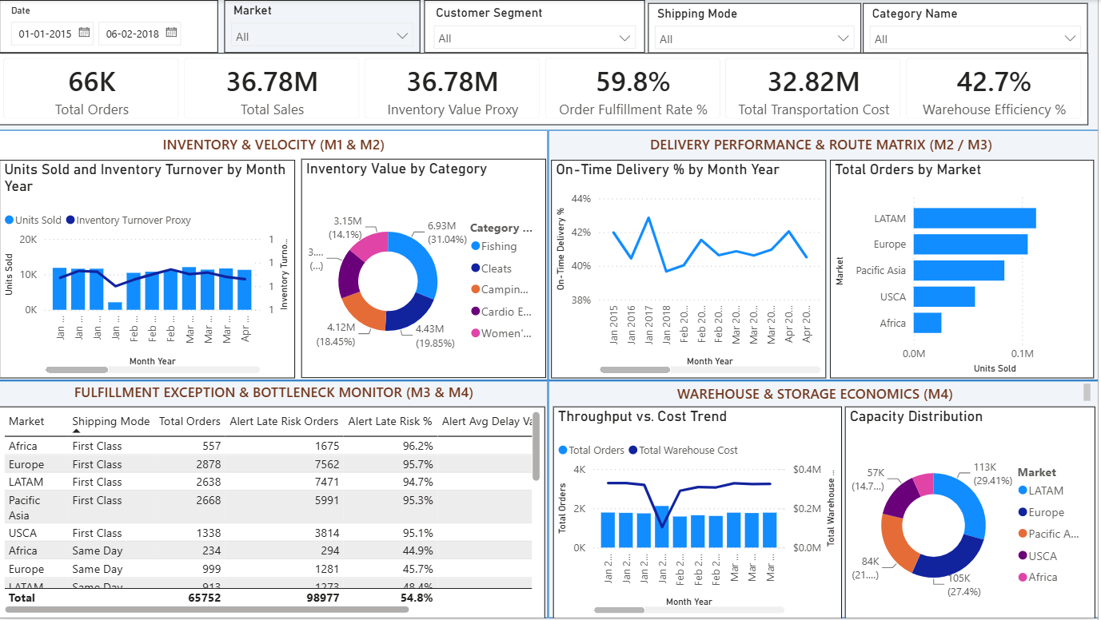
FINAL DASHBOARD
Complete Supply Chain Overview
66K
TOTAL ORDERS
36.78M
TOTAL SALES
59.8%
ORDER FULFILLMENT RATE %
All four milestones consolidated into one executive view — inventory & velocity, delivery performance, fulfillment exceptions and warehouse economics — filterable by date, market, segment, shipping mode and category.
09

Slide 10
CONCLUSION
Conclusion & Future Enhancements
WHAT WE DELIVERED
FUTURE ENHANCEMENTS
Built an integrated supply chain analytics dashboard in Power BI
Combined four milestones into one final, executive-ready solution
Delivered insights across inventory, delivery, supplier, transportation and warehouse performance
Converted raw operational data into meaningful KPIs, trends and visuals
1
Real-time data integration
2
Demand forecasting for better inventory planning
3
Predictive delivery-delay analysis
4
Automated alerts for high-risk orders
5
Advanced warehouse capacity forecasting
10

Slide 11
Thank You

